Slide 1
Networks
Notes:
two parts: network science and network visualization. they of course fit together, but we’ll discuss them each in turn.

Slide 2
The bridge problem
Notes:
the field of graph theory, now network science, began with a simple problem

Slide 3
https://commons.wikimedia.org/w/index.php?curid=112920
Notes:
konisburg

Slide 4
Notes:
euler, it’s not possible!
https://en.wikipedia.org/wiki/File:Leonhard_Euler.jpg

Slide 5
https://commons.wikimedia.org/w/index.php?curid=1680050
Notes:
the four color problem- turns out this is a graph theory problem too. it’s been solved by a computer!

Slide 6
Random networks
Notes:
Erdos-Renyi
Problem- we never see them in the real world

Slide 7
http://worrydream.com/ScientificCommunicationAsSequentialArt/
Notes:
small-world, we find these!
http://worrydream.com/ScientificCommunicationAsSequentialArt/

Slide 8
https://commons.wikimedia.org/w/index.php?curid=646994

Slide 9
Network vis

Slide 10
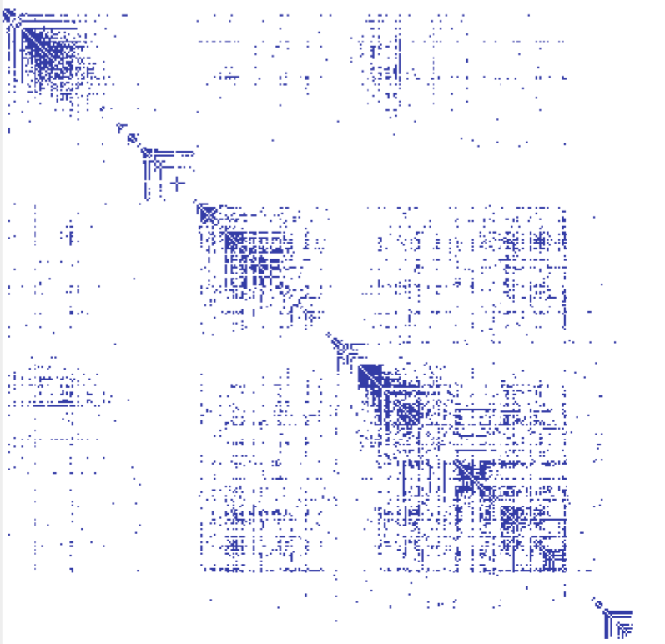
Data

Slide 11
Tournaments Organization Charts Genealogy Diagramming (e.g., Visio) Biological Interactions (Genes, Proteins) Computer Networks Social Networks Simulation and Modeling Integrated Circuit Design
Notes:
from Heer

Slide 12
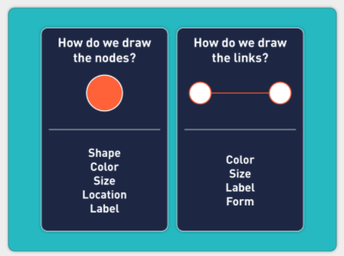
Nodes + Links
Notes:
from chris

Slide 13
Notes:
didn’t have to look far on my hard drive for this one…

Slide 14
Layout algorithms
Physics-based (VV)
“Tidying” layouts
Radial
Circular
Hierarchical (+trees)
Notes:
velocity verlet algorithm! called “force”
minimize space wasted on paper (reingold-tilfold)

Slide 15
Depends on the data!
Notes:
no layout algorithm here
http://ecs-network.serv.pacific.edu/past-courses/2015-fall-ecpe-177/facebook-world-friend-map/view

